Slide 1
MS SQL Server Training
Timo Witza
für Lufthansa Systems

Slide 2
Agenda
Day 1
General administration knowledge
Security administration
Management tools
Cluster configuration of MS SQL Server

Slide 3
Agenda
Day 2
Backup and restore administration with Veritas NetBackup
Disaster recovery
Other MS SQL features (Replication, Mirroring, SSIS, SSRS, SSAS, BOL)
new features in SQL Server 2008

Slide 4
General administration
Database engine, instances
System databases
Functions
Maintenance
Typical problems and solutions
Databases
Data files
Recovery model, collations
Backup and restore (standard MSSQL procedure)
General maintenance
Shrinking
Taking offline and online, attach and detach database files
Typical problems and solutions
Script button

Slide 5
Security administration
Managing logins and users
Setting up permissions on each database
Checking permissions

Slide 6
Management tools
Enterprise Manager (SQL Server 2000)
Management Studio (SQL Server 2005 and 2008)
SQL Server Configuration Manager
Performance management
SQL Server Profiler
Database Engine Tuning Advisor
Command line tools (OSQL, SQLCMD)

Slide 7
Cluster configuration of MS SQL Server
General clustering
Prerequisites
Domain integration
Storage
Heartbeat
MS SQL Specific needs
Maintenance and troubleshooting

Slide 8
Implementing a Single-Instance SQL Server 2008 Failover Cluster
Configure the shared storage for the failover cluster
Install the Failover Cluster feature
Run the Validate Cluster Configuration Wizard
Create the Windows Server 2008 failover cluster
Implement DTC (depending on which features will be installed)
Install the first SQL Server 2008 failover cluster node
Add additional SQL Server 2008 failover cluster nodes

Slide 9
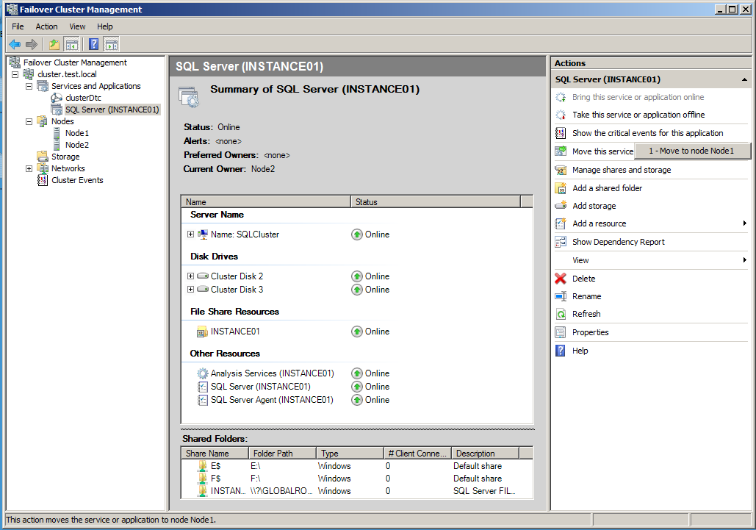
Failover Cluster Management

Slide 10
Backup and restore administration with Veritas NetBackup
Checking the backups in Veritas NetBackup Client
General usage of NetBackup MS SQL Agent
Connection properties
Client properties
Sript file management
Managing backups
Managing restore operations
Simple restore
Point in time recovery
Database move
Restore to different host

Slide 11
Disaster recovery
Start SQL Server in Single User Mode
CD C:\Programme\Microsoft SQL Server\MSSQL.1\MSSQL\Binn
sqlservr.exe -c -m
If SQL Server is running and system databases backups available, restore system databases:
RESTORE DATABASE master FROM DISK = 'C:\AWBackups\master.bak'
If system databases backups are not available or SQL Server does not start in case of master db damage, rebuild master database and other system databases using setup.exe /qn …

Slide 12
Rebuild SQL Server 2005 system databases
Insert media, start from command prompt :
start /wait <CD or DVD Drive>\setup.exe /qb INSTANCENAME=MSSQLSERVER REINSTALL=ALL REBUILDDATABASE=1 REINSTALLMODE=omus SAPWD=<NewStrongPassword>
supported values for REINSTALLMODE :
O - Reinstall if the file is missing or if it is an older version M - Rewrite machine-specific registry keys under HKLM U - Rewrite user-specific registry keys under HKCU S - Reinstall all shortcuts
Further Information and other scenarios see
http://msdn.microsoft.com/en-us/library/ms144259%28SQL.90%29.aspx

Slide 13
Other MS SQL features:
Database replication
Database mirroring
Integration Services (SSIS)
Reporting Services (SSRS)
Analysis Services (SSAS)
SQL Server Books Online

Slide 15
SQL Server 2008 new features
Encryption
Clustering
Policy based Management
PowerShell
Backup compression
Hyper-V support

Slide 16
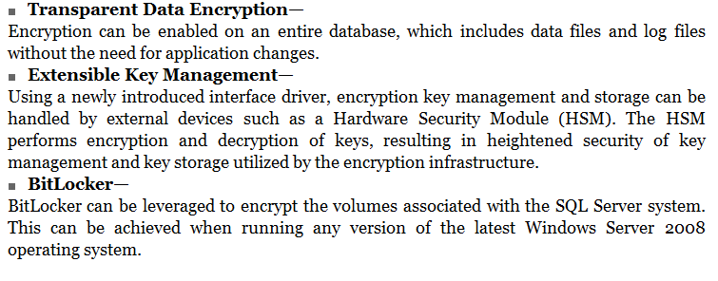
Encryption

Slide 17
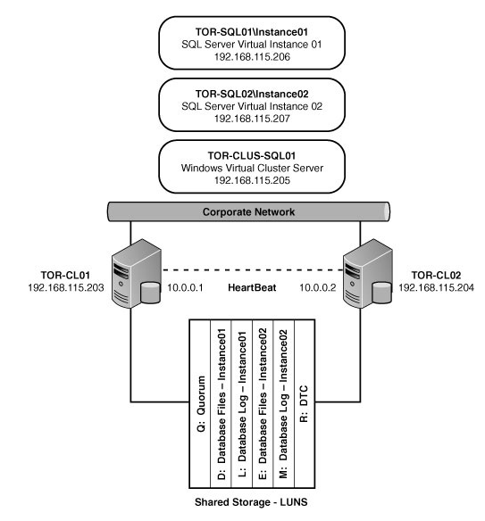
New in SQL Server 2008 Clustering
Terminology is now "Failover Cluster"
New Cluster Validation Tool
Installation redesigned to per-node-basis
New tool in SQL Server 2008 Installation center for wizard based advanced cluster preparation and advanced cluster cluster completion
Failover installation process is fully scriptable
Cluster management interface redesigned
Quorum drive is no longer a single point of failure
IP 6 support
Nodes do not need to be in same subnet

Slide 18
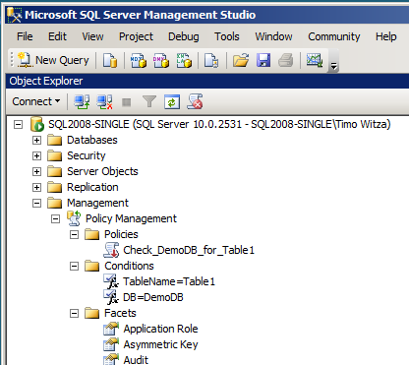
Policy based Management
Facets
Conditions
Policies
Categories
Targets
Execution mode
Central Management Servers
You can evaluate or force…

Slide 19
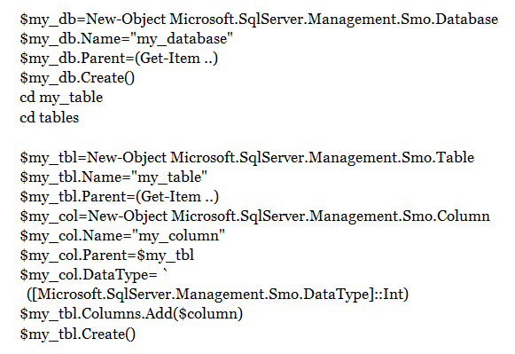
Powershell Example: Create Table

Slide 20
Backup Compression
Included in Enterprise and Developer Edition only
By Database: Backup database WITH COMPRESSION
By Server: sp_configure 'backup compression default','1'; RECONFIGURE WITH OVERRIDE

Slide 21
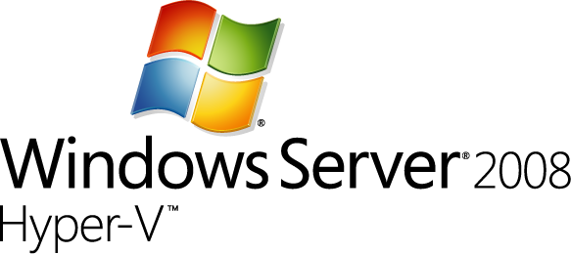
Hyper-V support
SQL Server 2008 instances ca be hosted in a Hyper-V Server environment
Install Hyper-V Role on host system
supports 32- or 64-bit guest OS, up to 64 GB RAM and up to 4 cores per guest session
Manage guest servers with server manager or Hyper-V administrative mmc console

Slide 22
Any Questions?
?

Slide 23
Thanks for your attention…
twitza@gmx.de

